Slide 1
Sportzen
By Localhost:3000

Slide 2
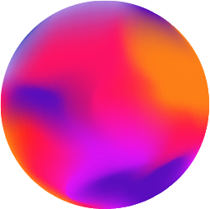
Abstract
There are many unpopular sports in India and their populars who are unrecognized or rather underrated even after giving their best day in and day out . The players of these sports like chess, football, table-tennis keep working hard but still don’t get the recognition they deserve. What if we can help them by connecting their abilities with new-age tech?

Slide 3
What we are working on
Blockchain
AR
More specifically, NFTs. Moments of the famous play by the underrated players captured and converted to NFT.
AR is used to provide virtual experience of NFTs in our surrounding, inside our room.

Slide 4
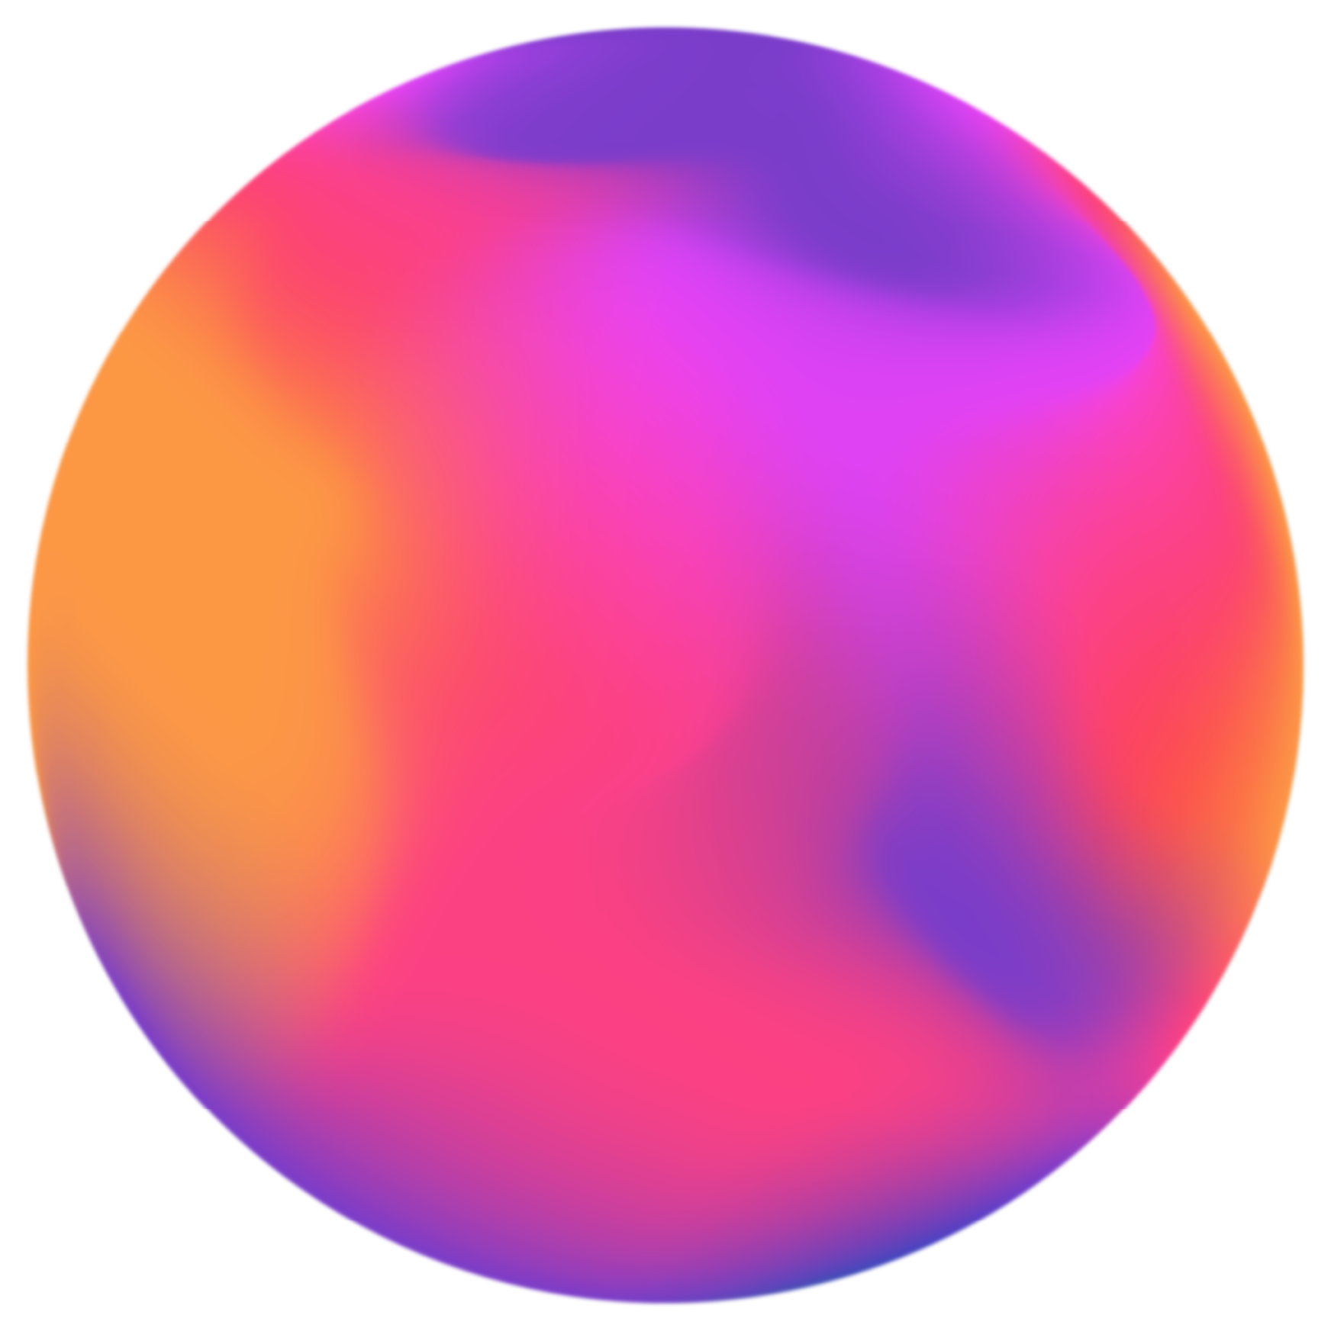
About the project
In order to bring in more recognition and to make such things mainstream, we are planning to take some important moments from the games played by players/teams and take certain moments and make NFTs of those situations.
For example: Let’s take a chess game, between 2 players, we will capture some really amazing moments and put them up for voting in this blockchain application. An amount of the transaction will go the promotion of these unpopular sports in India and also for the upliftment of its players.

Slide 5
The best voted ones will be put up in an auction from where users can put bids on the various available NFT's and the highest bidder will own that NFT.
We are also planning to give a virtual preview of the NFT using Augmented Reality(similar to preview for products). This will give the sneak peek to the NFT and the one thing which makes our idea unique and novel

Slide 6
Novelty
Use of the popular NFTs to promote underrated sports.
Augmented Reality being used to give a virtual experience of a Non Fungible Token in our preferred surroundings.

Slide 7
Tech Stack
Ethereum/Polygon
AR-js
Nodejs
Reactjs
Solidity
Heroku

Slide 8
Future scope
Implementation of virtual reality ( VR ) so that the users who buy this feel they are living this moment.
Collaboration with other major blockchain companies to promote these sports
Functionality for users to make their own NFT and upload it on the website.

Slide 9
Sneak peek

Slide 10
Our Team
Aman
Sahas
Dibyan
Avinash
Sharma
20BCT0267
Vivek
20BCE2701
Goswami
20BEE0059
Singh
20BCE0494

Slide 11
Thank
You!

